Slide 1
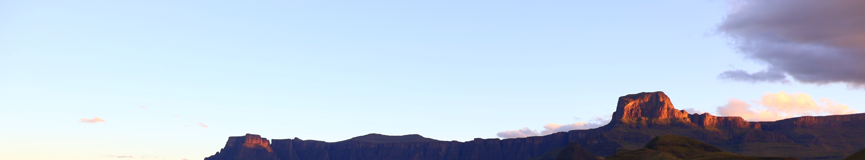

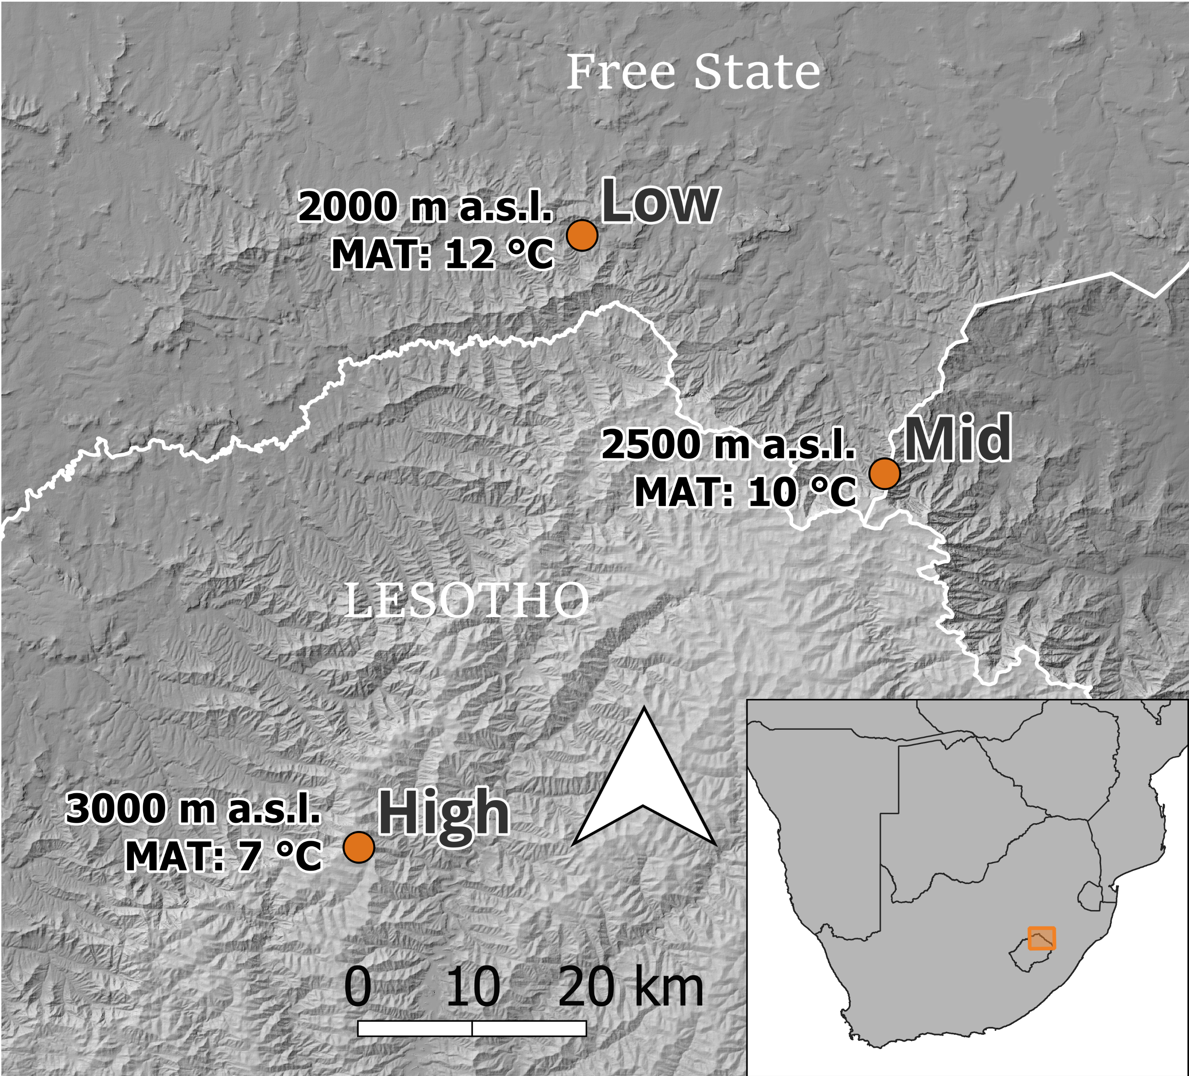
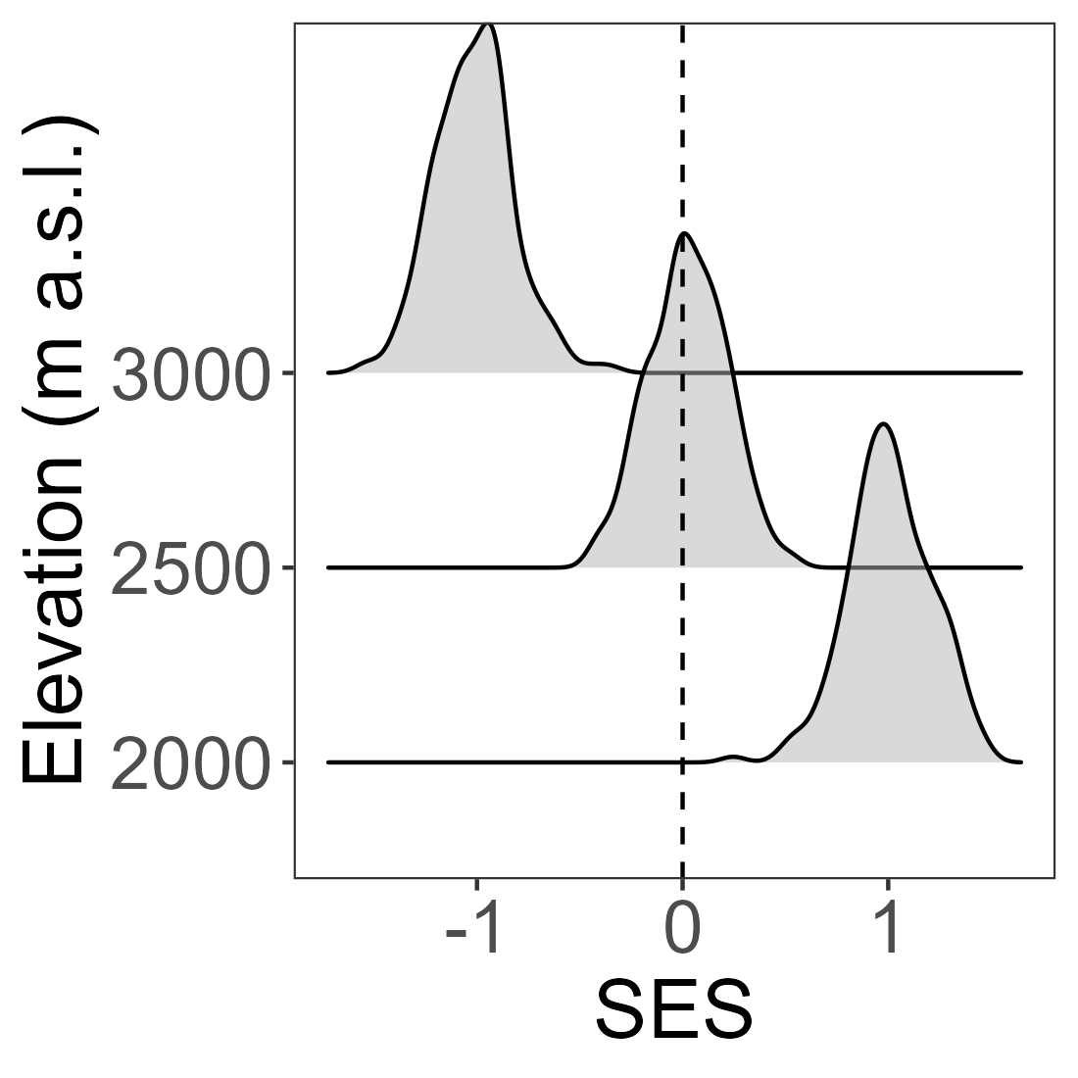
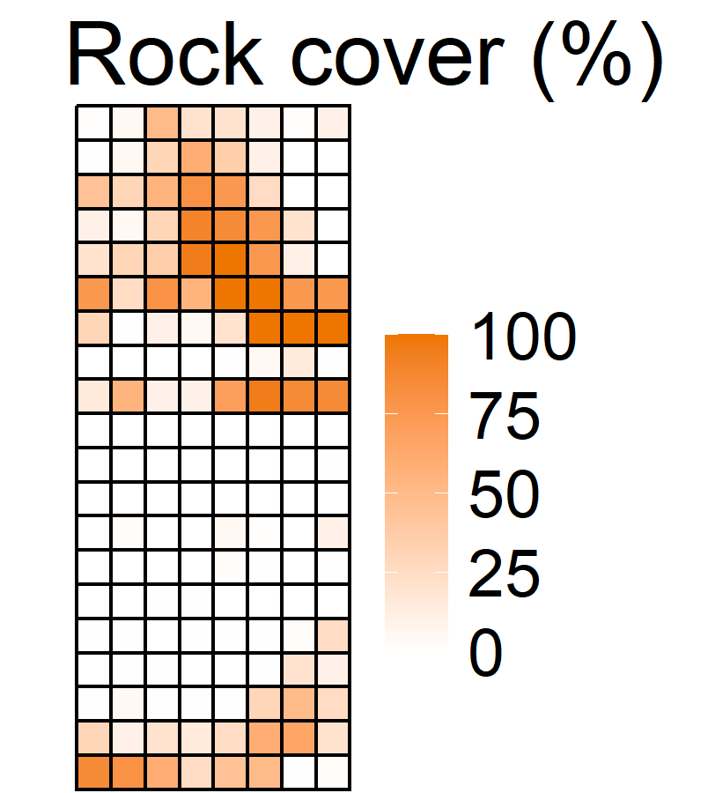
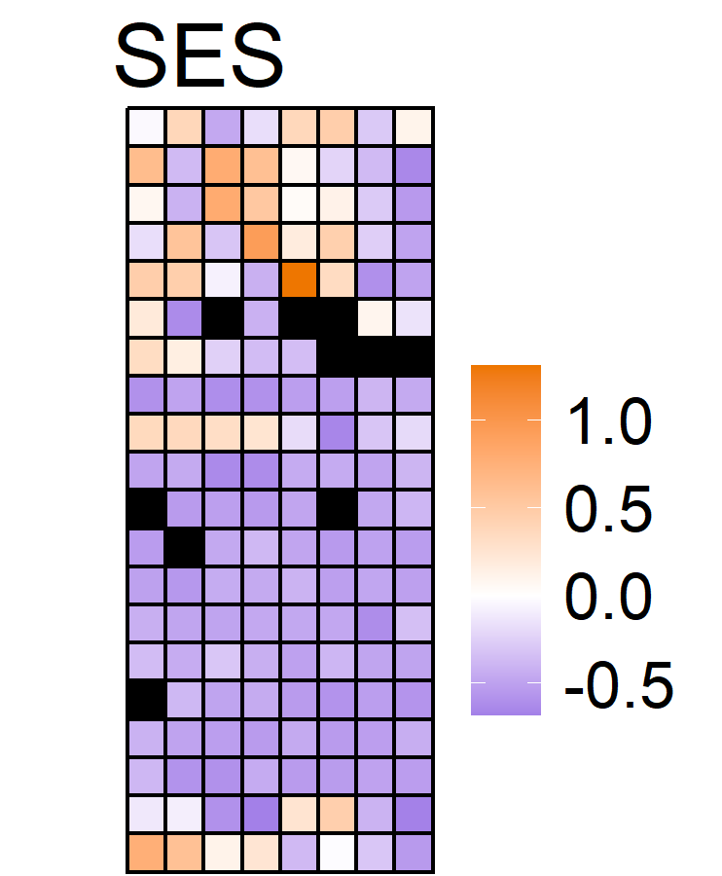
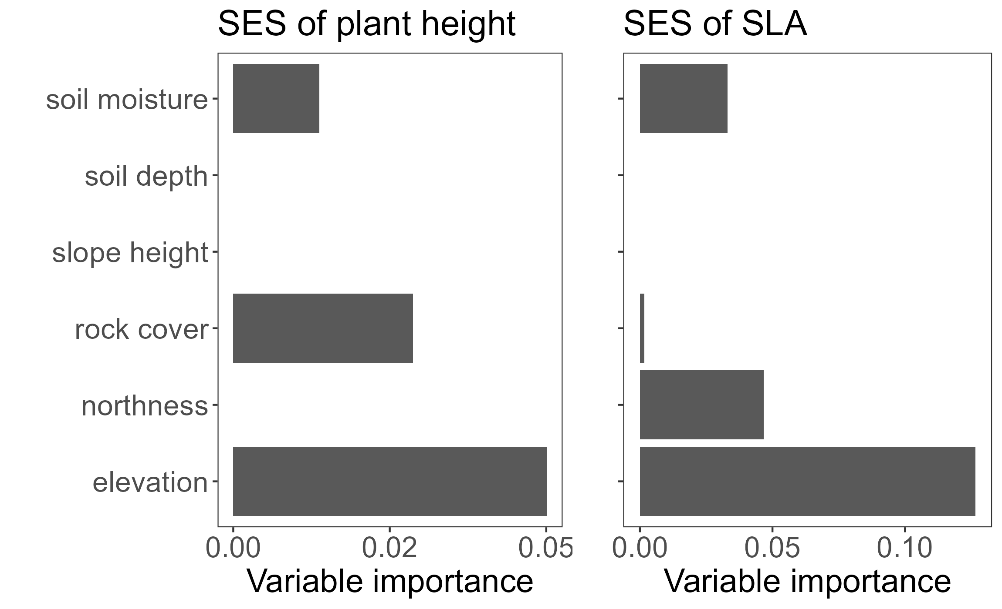
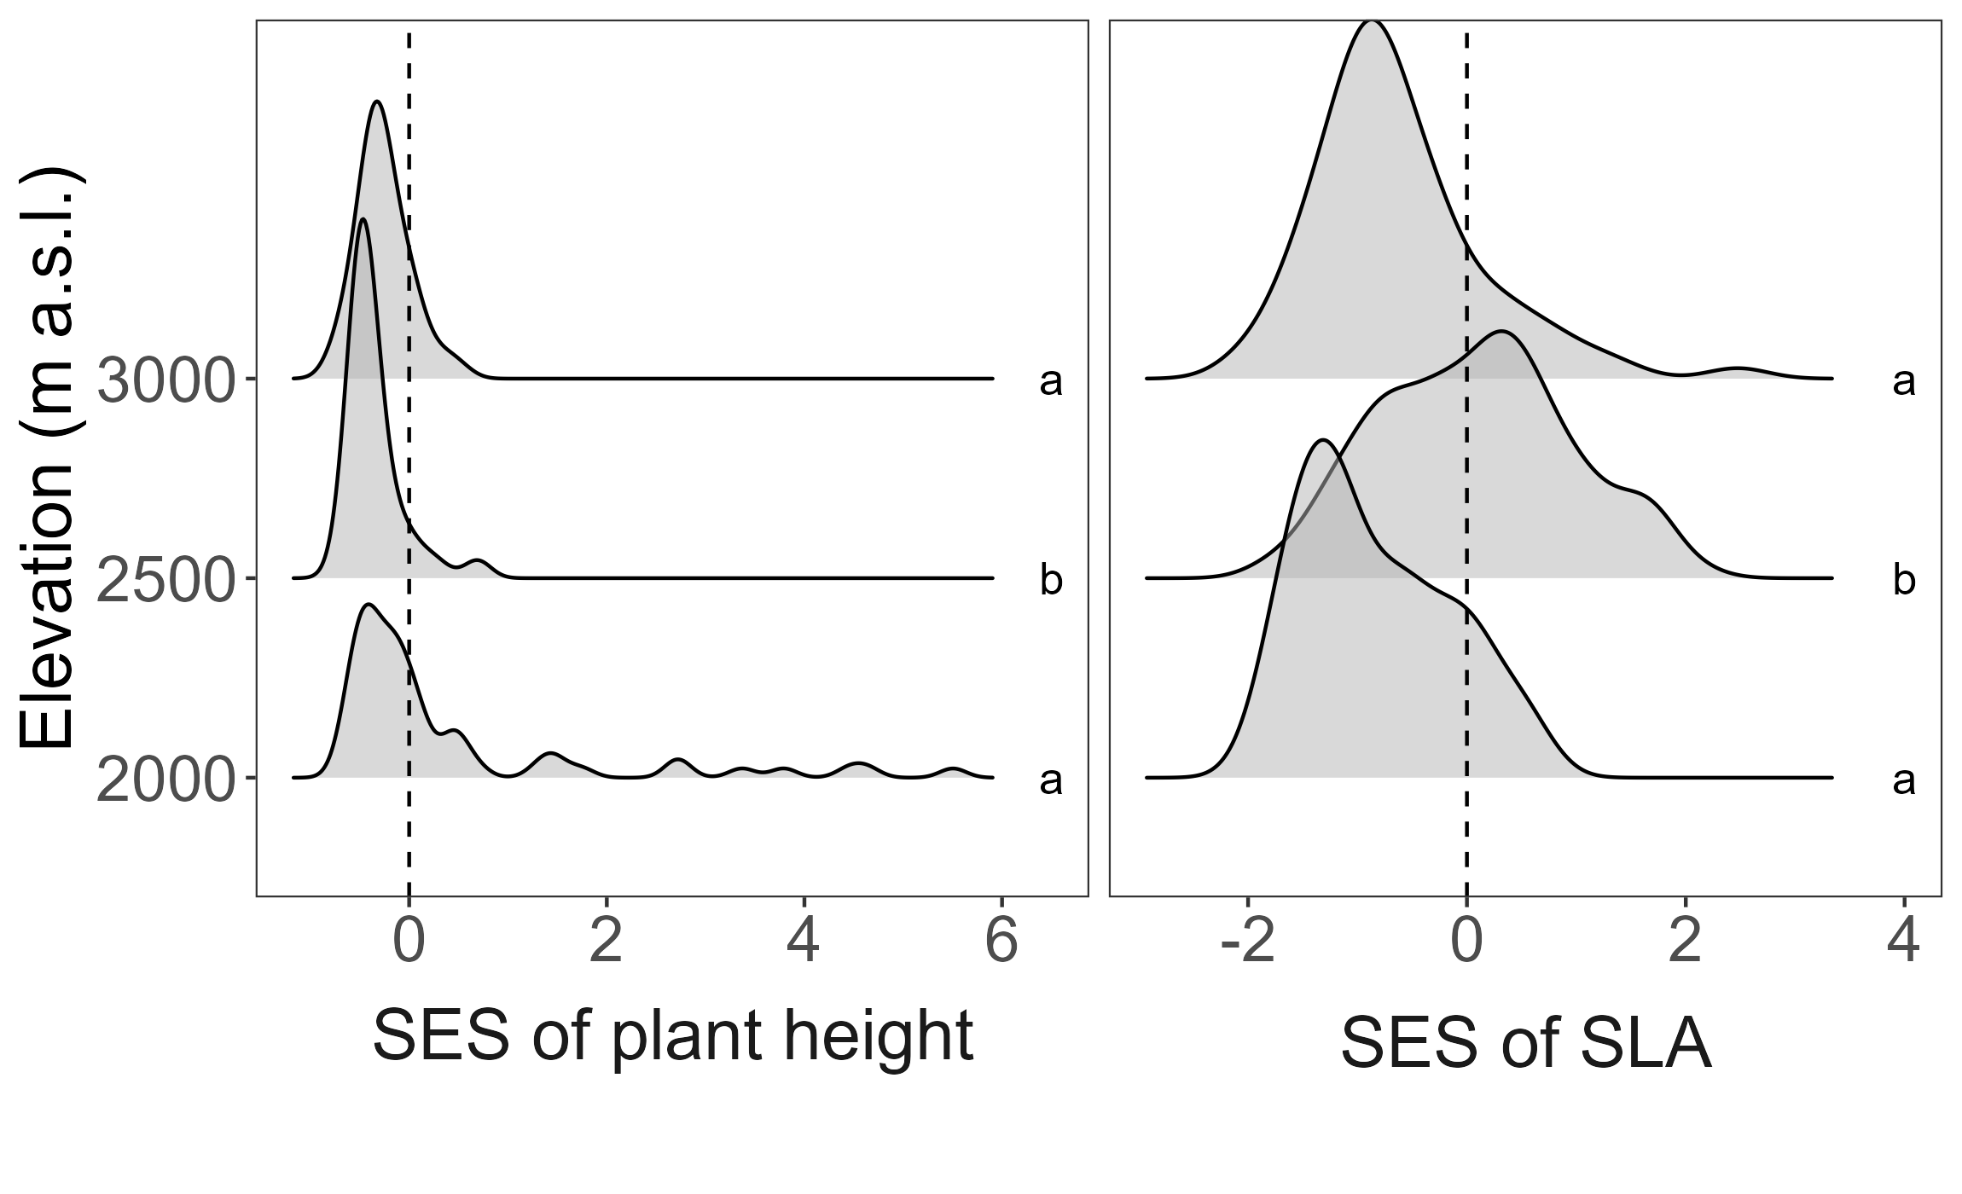
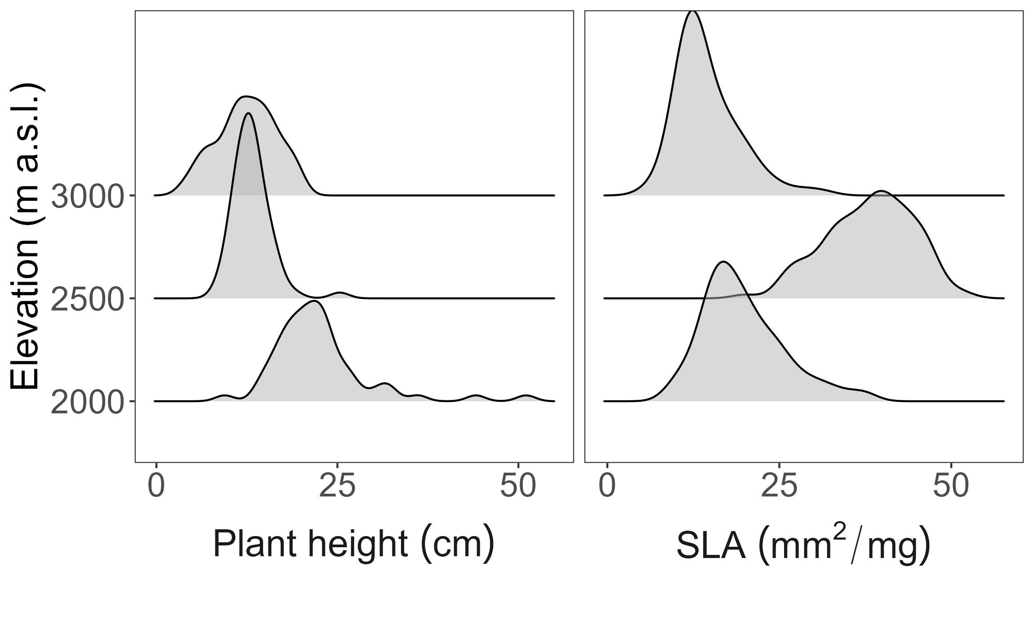
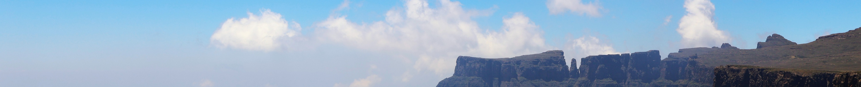


Community assembly processes in a montane grassland are not driven by environmental factors
imke.smit@tuks.co.za
Imke Chrissie Smit¹, Morgan Raath-Krüger², Ralph Clark³, Aud Helen Halbritter⁴, Peter le Roux¹
There are two main models of community assembly:
Environmental filtering: The environment filters out species that do not have appropriate traits, creating a pattern of trait convergence toward an optimum trait.
Limiting similarity: Competition excludes species with similar traits, creating a pattern of trait divergence.
The importance of environmental filtering in community assembly is expected to increase with environmental severity. However, community assembly mechanisms may vary considerably at fine scales.
Hypotheses
Community assembly shifts from limiting similarity to environmental filtering with elevation
Micro-environmental differences create fine-scale variation in community assembly
Figure 1: Sites along an elevational gradient in the Maloti-Drakensberg of South Africa and Lesotho.
Methods
Species composition, functional trait (plant height and specific leaf area [SLA]) and microenvironmental data were collected from three sites in the Maloti-Drakensberg spanning an elevational gradient of 1000 m (Fig. 1).
Data was collected in sampling grids consisting 160 contiguous 1 m² cells.
To determine whether cell-level trait diversity (RaoQ) differed from a null model of random assembly, we calculated a standardized effect size (SES)
SES > 0 indicates greater trait diversity than expected under random assembly (indicative of limiting similarity).
SES < 0 indicates lower trait diversity than expected (indicative of environmental filtering).
Generalized linear mixed effect models: SES ~ elevation + microenvironmental variables + (1|grid)
Results and discussion
Figure 2: Importance of environmental variables in predicting the deviation of diversity in height (SES of plant height) and diversity in SLA (SES of SLA) from random assembly.
Figure 3: Distribution of SES of plant height and SLA at low, mid and high elevation. Letters reflect significant differences in the mean SES of each elevation.
Figure 4: Community weighted mean traits of cells at low, mid and high elevation
Models explained little variation in the SES of plant height (marginal R² = 0.09, conditional R² = 0.11) and SLA (marginal R² = 0.22, conditional R² = 0.27).
Elevation was the most important variable in predicting the deviation of diversity in height and SLA from random assembly (Fig. 2), although environmental filtering was the dominant assembly mechanism for plant height and SLA at all elevations (Fig. 3).
Environmental filtering shifted communities toward increasingly shorter height with elevation, likely due to the increased cold tolerance of short- statured plants (Fig. 4).
The SLA of communities were filtered toward conservative leaf-economic strategies at the low and high elevation, but selection shifted to a more acquisitive leaf-economic strategy at the mid elevation (Fig. 4). This may reflect reduced temperature constraints on growth, or a competitive advantage of high-SLA species at the mid elevation.
Microenvironmental variation only weakly explained fine-scale variation in SES, suggesting that fine-scale variation in community assembly signatures may be the result of stochastic processes.
Affiliations:
1- Department of Plant and Soil Sciences, University of Pretoria, Pretoria, South Africa.
2 – Department of Botany and Plant Biotechnology, University of Johannesburg, Auckland Park 2006, South Africa.
3 - Afromontane Research Unit and Department of Geography, University of the Free State: Qwaqwa Campus, Phuthaditjhaba, South Africa.
4 – Department of Biological Sciences and Bjerknes Centre for Climate Research, University of Bergen, Bergen, Norway
Acknowledgements:
NRF (grant number 129334). Witsieshoek Mountain Lodge and the Batlokoa Royal House. DESTEA (permit number 202108000007627). SANParks (Agreement SS225). Lesotho Ministry of Tourism, Environment and Culture. Imke Smit was funded through a Doctoral Research Bursary from the University of Pretoria.
Notes:
Environmental filtering was the dominant assembly mechanism for all traits at all elevations. Environmental filtering shifted communities toward increasingly small size with elevation due to the increased cold tolerance of short-statured plants. The SLA of communities were filtered toward conservative leaf-economic strategies at the low and high elevation, but selection shifted to a more acquisitive leaf-economic strategy at the mid elevation. This may reflect a relaxation of temperature limitations on growth, or a competitive advantage of high SLA at the mid elevation. Microenvironmental variation only weakly explained small-scale variation in SES, suggesting that small scale variation in community assembly signatures are the result of stochastic processes.

